Slide 1


Rajshahi University of Engineering & Technology
Department of Mechatronics Engineering
MTE 4110 SEMINAR
A Presentation on “Thesis Topic Selection”
Supervisor:
Sumaya Ishrat Moyeen
Assistant Professor,
Department of Mechatronics Engineering, RUET.
Group Members:
1. Name: Md. Akkhor Hasan
Roll: 2008028
2. Name: Sumaiya Rahman Oishy
Roll: 2008037

Slide 2
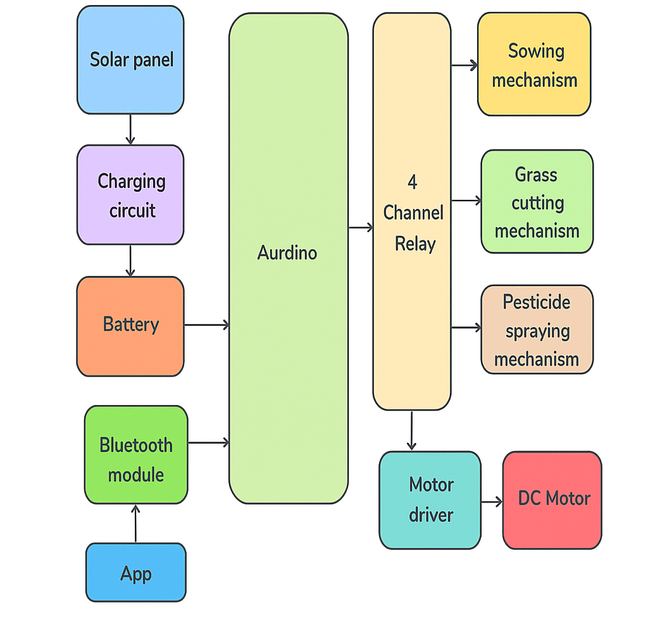
Rajshahi University of Engineering & Technology
Solar Powered Autonomous Multipurpose Agricultural Robot with Sensor Feedback for Precision and Enhancement via Bluetooth Free App
Introduction: Agriculture today requires automation and smart solutions to boost productivity and reduce labor efforts. This project presents a solar-powered agricultural robot with sensors and Bluetooth app control to automate tasks like seed sowing, grass cutting, and pesticide spraying, ensuring efficient and sustainable farming.
Motivation: Conventional farming is labor-intensive, time-consuming, and less efficient. With rising food demands, there is a need for eco-friendly and automated systems. A solar-powered robot with sensor feedback offers precision, reduces human effort, and promotes sustainable agriculture.
Objectives:
Develop a solar-powered multipurpose agricultural robot capable of performing tasks such as seed sowing, grass cutting, and pesticide spraying.
Integrate key sensors and feedback mechanisms (soil moisture, seed level, temperature & humidity, and battery status) for precision farming and adaptive control.
Implement a Bluetooth-enabled mobile application for real-time monitoring and remote control of the robot.
Fig.1. Block diagram of the Automated Seed Sowing,
Grass Cutting and Pesticide Sprayer Robot
Using Bluetooth
References:
Milufarzana, Banu, S., Or-Rashid, M. H., & Hasan, M. R. (2025). Fabrication and performance evaluation of a solar-powered multipurpose agricultural machine. Agricultural Engineering International: CIGR Journal, 27(1), 85–94. https://www.researchgate.net/publication/390582066

Slide 3
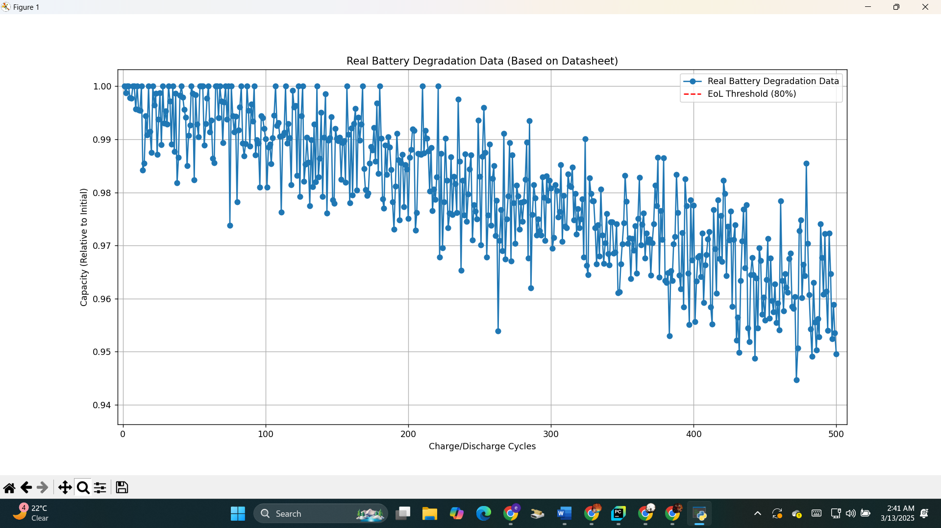
Rajshahi University of Engineering & Technology
AI-Enhanced Digital Twin for Predictive Analytics of
Battery Health and Degradation Dynamics
Introduction: Efficient battery management is crucial for energy storage systems and electric vehicles. This project focuses on developing a digital twin model that predicts battery health, capacity, and remaining life using real-time sensor data, enabling accurate monitoring and predictive maintenance.
Motivation: Battery failures often result in costly downtime and reduced performance in electric vehicles and storage systems. Traditional methods for estimating battery life are less accurate due to dynamic operating conditions. A digital twin approach provides a virtual replica of the battery, improving prediction accuracy and supporting proactive maintenance strategies.
Objectives:
Develop a digital twin model that replicates the real-time behavior and performance of a battery system.
Predict battery health parameters such as state of health (SoH), capacity, and remaining useful life (RUL) using real-time data.
Enhance predictive maintenance by enabling early detection of battery degradation and optimizing energy management.
Fig.2. A Graph of the Real Battery Degradation Data
References:
Renold, P. A., & Kathayat, N. S. (2023). Comprehensive Review of Machine Learning, Deep Learning, and Digital Twin Data-Driven Approaches in Battery Health Prediction of Electric Vehicles. IEEE Access, XX, 1–45. https://doi.org/10.1109/ACCESS.2024.3380452

Slide 4
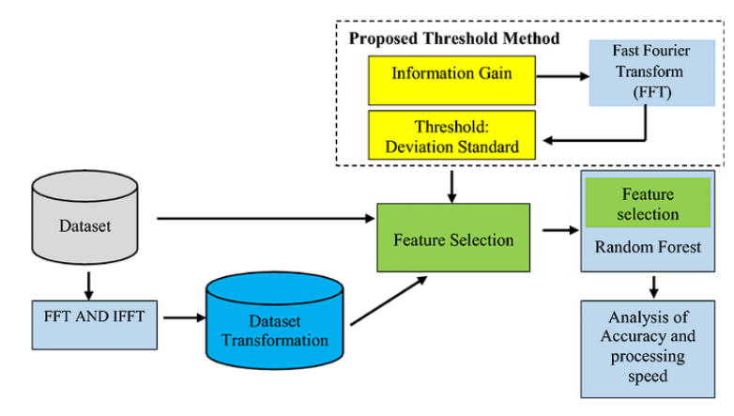
Rajshahi University of Engineering & Technology
Predictive Maintenance Architecture Using Edge-AI and Machine Learning for Industrial Machinery
Introduction: Industrial machines are critical assets whose unexpected failures can result in high maintenance costs and production delays. This project focuses on developing a predictive machine health monitoring system that leverages real-time sensor data and machine learning to detect early fault indicators and optimize maintenance strategies.
Motivation: Unplanned machine failures cause costly downtime and inefficiencies in industries. Traditional maintenance methods lack predictive capabilities, while machine learning with real-time sensor data enables early fault detection, proactive maintenance, and improved operational reliability.
Objectives:
Develop a real-time health monitoring system using industrial sensor data (vibration, temperature, etc.) for fault detection.
Implement machine learning algorithms to predict anomalies and enable proactive maintenance.
Minimize downtime and maintenance costs by generating early alerts and optimizing machine reliability.
Fig.3. Workflow of the Proposed Threshold-Based Feature Selection Method Using FFT and Random Forest
References:
Ranjan, R., & Mitta, N. R. (2024). AI-enhanced predictive maintenance systems for industrial equipment: Developing machine learning models to forecast failures, optimize maintenance schedules, and minimize downtime. Distributed Learning and Broad Applications in Scientific Research, 10, 550–590. DLABI.

Slide 5
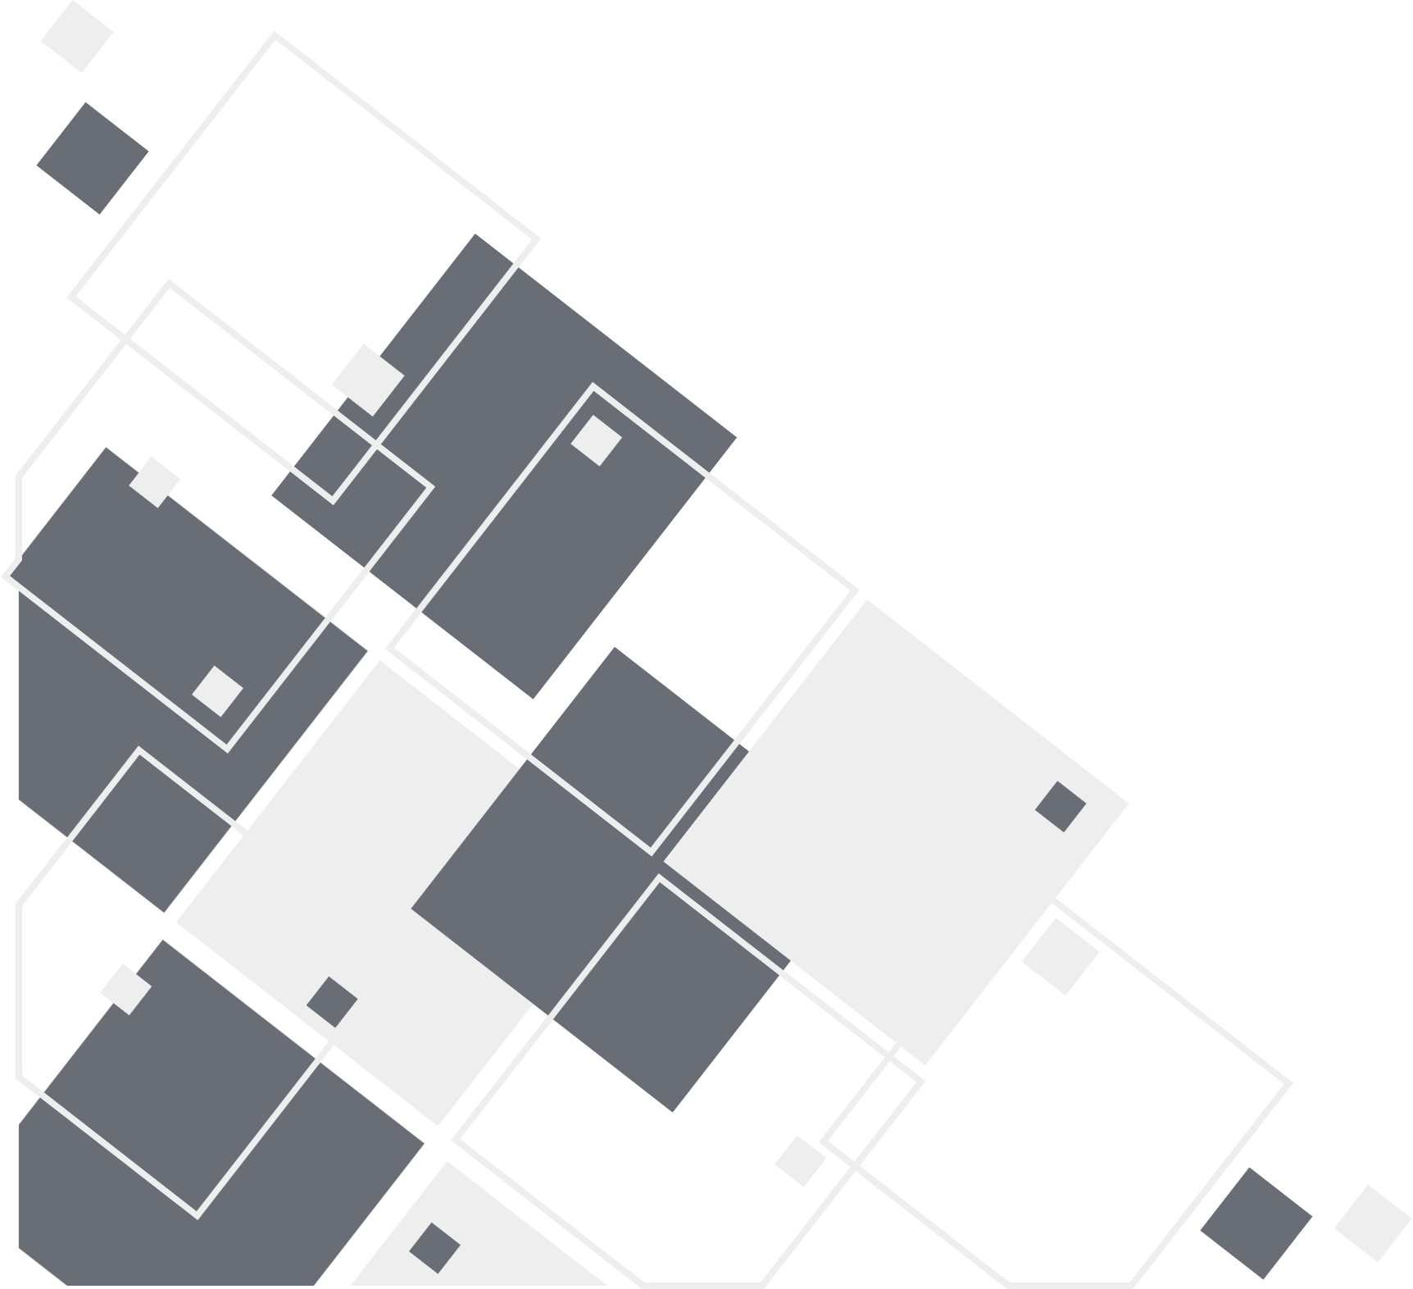
THANK YOU

